Slide 1
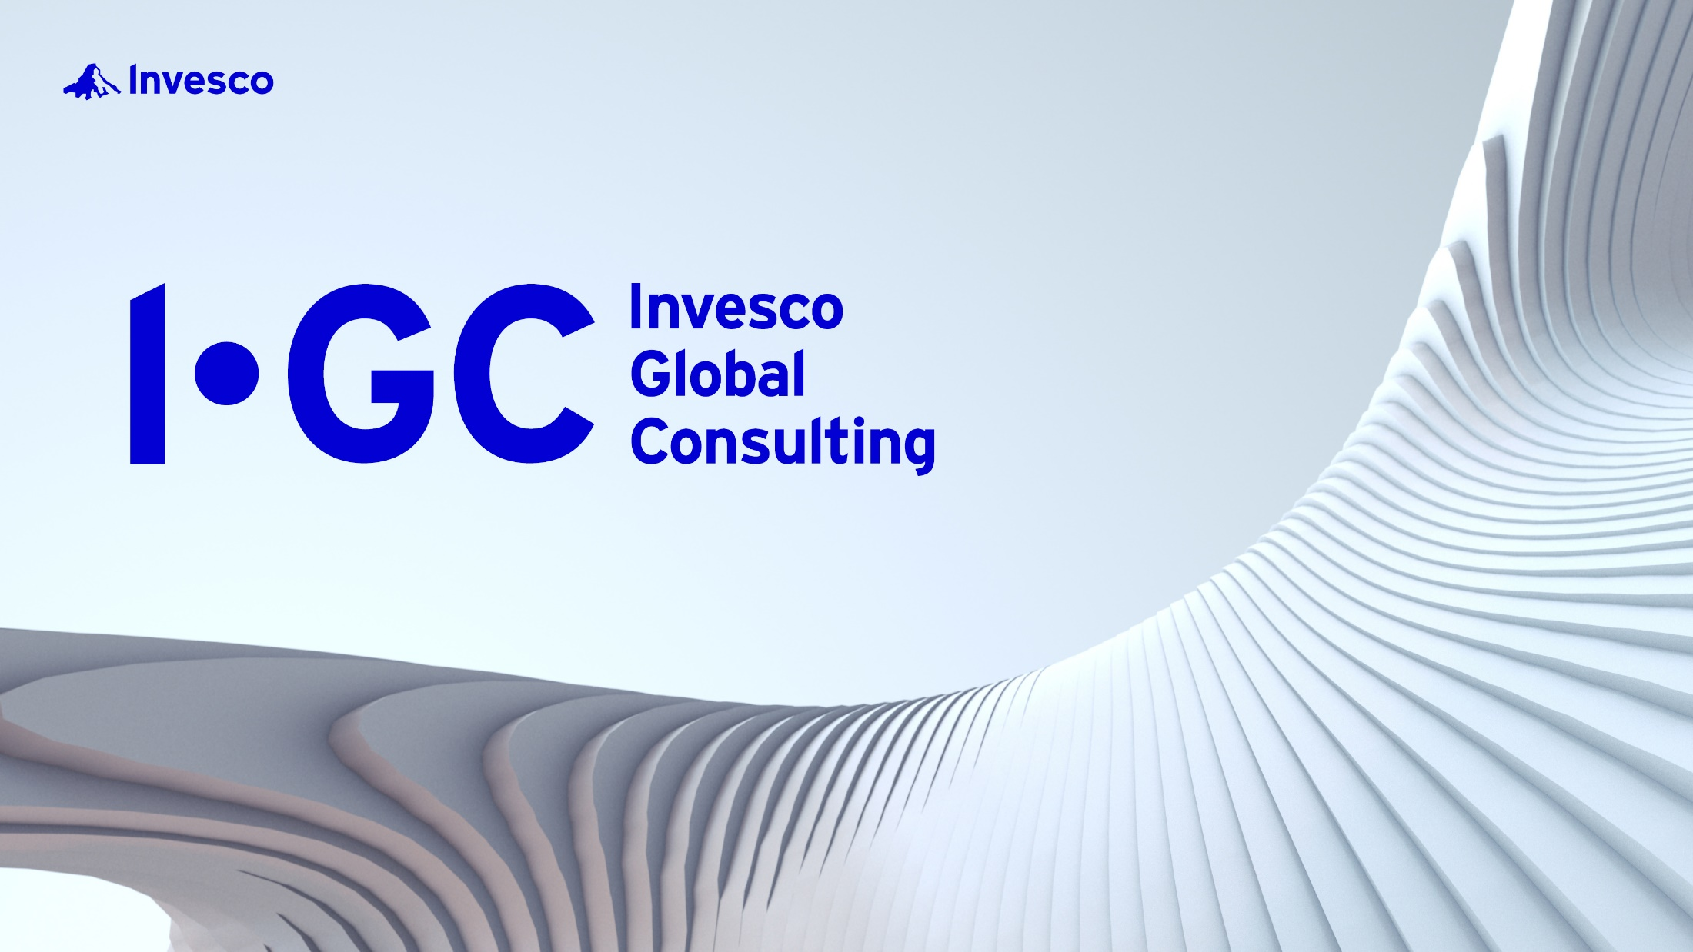
Not a Deposit | Not FDIC Insured
Not Guaranteed by the Bank | May Lose Value
Not Insured by any Federal Government Agency
Notes:
Speaker’s note: This presentation must be used in its entirety. It cannot be changed or altered in any way without being reapproved/refiled.
Welcome. I’m Paul Brunswick, Head of Invesco Global Consulting. We’re happy to be with you today!

Slide 2
Invesco is committed to helping you and your clients achieve greater outcomes by focusing on…
Today’s financial professionals serve clients who have increasingly complex and diverse needs. In our view, this requires the ability to build a comprehensive
wealth management infrastructure delivered by
a diverse team of specialists.
To help you construct and deliver this business
model to your high-net worth clients, IGC partners
with Invesco’s Solutions Group to deliver a coaching
and consulting capability focused on these 3 areas:
Your Business
Optimize the structure of your practice and lead a team of knowledgeable financial professionals
Your Portfolios
Elevate your investment process to align objectives
with intentions
You
Your Clients
Manage clients’ emotions,
keep them “buckled-in” to their investment plans and promote enduring family legacies
For illustrative purposes only
FOR INSTITUTIONAL INVESTOR USE ONLY - NOT FOR USE WITH THE PUBLIC
Notes:
We are committed to helping you and your clients achieve greater possibilities by focusing on your business, your clients, and your portfolios.
Today’s financial professionals serve clients who have increasingly complex and diverse needs. This requires the ability to build a comprehensive wealth management infrastructure, delivered by a diverse team of specialists.
To help you construct and deliver this business model to your high-net worth clients, Invesco has created a coaching and consulting capability focused on these 3 areas.

Slide 3




What we offer
The four rooms of your practice
New Business Development
Create a consistent flow
of new clients through:
Strategic partnerships
Consistent client referrals
Social prospecting
Wealth Management
Implement a comprehensive wealth
management strategy by integrating:
Deep discovery processes
Wealth management implementation tool
Comprehensive annual review structure
Client Service
Craft an exceptional client
experience by implementing:
Segmentation strategy
Service stratification model
Client communication structure
Practice Management
Construct a high-performance
practice by instituting:
Synergistic team structure
Collaborative culture
Long-term succession planning
For illustrative purposes only
FOR INSTITUTIONAL INVESTOR USE ONLY - NOT FOR USE WITH THE PUBLIC
Notes:
At IGC, we like to think of your practice as a house with four rooms.
(Review slide.)

Slide 4

What we offer
New Business Development
Create a consistent flow
of new clients through:
Strategic partnerships
Consistent client referrals
Social prospecting
For illustrative purposes only
FOR INSTITUTIONAL INVESTOR USE ONLY - NOT FOR USE WITH THE PUBLIC
Notes:
Today we’re going to focus on the new business development room, and in particular on our research-based referrals program we call “Preferrals.”

Slide 5
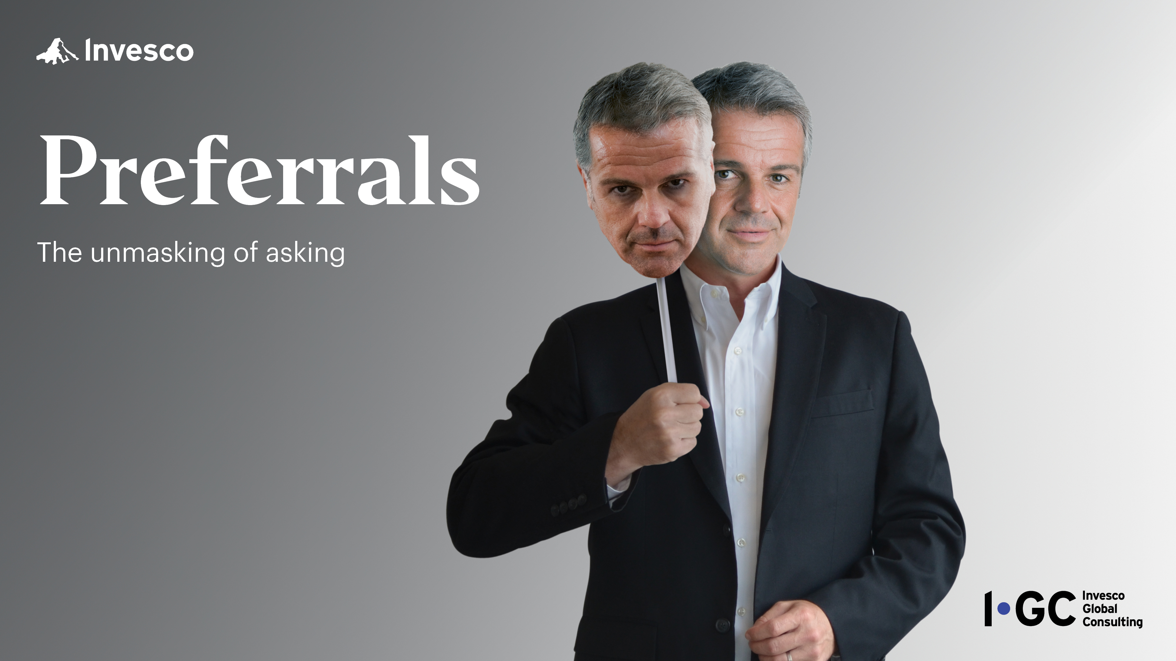
5
FOR INSTITUTIONAL INVESTOR USE ONLY - NOT FOR USE WITH THE PUBLIC
Notes:
Asking for referrals is flat-out one of the hardest parts of this busines. “Preferrals“ seeks to change that for you.

Slide 6
Where do you get your growth?
Client acquisition strategy | #1 source of new clients
1. Seminars
2. Cold calling
3. Walk ins
4. Referrals from clients
5. Referrals from attorneys & CPAs
6. Advertising
7. Community sponsorships
8. Social media
9. Networking events
10. Direct mail
P
77.5%
Source: R. A. Prince & Associates, Inc. January 2013 study of 338 financial professionals with an income between $200k and $500k after expenses and before taxes.
6
FOR INSTITUTIONAL INVESTOR USE ONLY - NOT FOR USE WITH THE PUBLIC
Notes:
Where do you get your business growth?
We ran this question by 338 financial professionals in 2013 and asked them this very question and learned that 77.5% of financial professionals ranked this as their number one growth strategy. Clearly, client referrals are a powerful engine of growth, and since this was a group of successful financial professionals, as you can see at the bottom of this slide, we assumed that they must be regularly seeking these referrals as part of their business growth strategy. So that was our next question.

Slide 7


“How often do you ask for referrals?”
11.9%
Source: R. A. Prince & Associates, Inc. January 2013 study of 338 financial professionals with an income between $200k and $500k after expenses and before taxes.
7
FOR INSTITUTIONAL INVESTOR USE ONLY - NOT FOR USE WITH THE PUBLIC
Notes:
Specifically, we asked if they had proactively asked for a referral over the last calendar year- not received one on an unsolicited basis, but actually asked for one. I’ll ask you to answer that question for yourselves; it’s interesting to think about!
Here’s what we found in the research- about 12% said that they had asked at least once, which, of course, means that a whopping 88.10% asked exactly zero times!
The results of this research are stunning; the industry just isn’t doing this. That’s why we call referrals the industry’s greatest “Liar’s Box.” Seemingly everyone thinks other financial professionals are asking and having success, but the truth is virtually no one is asking.
So, we set out to understand why, and what we heard most often is that asking can be uncomfortable-for both financial professionals and their clients.

Slide 8

Asking creates imbalance
WHOA!
Do you know anyone…?
8
For illustrative purposes only.
FOR INSTITUTIONAL INVESTOR USE ONLY - NOT FOR USE WITH THE PUBLIC
Notes:
The reason why it can be comfortable is due to a term psychologists call “relational equilibrium.” It refers to the unspoken set of expectations that exists in relationships between any two people. It can exist between employer and employee, between parent and child. It can even exist in a seemingly insignificant relationship between, for example. a server at a restaurant and a patron at that restaurant. If you went out for dinner in your server approached you and asked you to pour your own water and get your meal when it came up in the kitchen you would probably feel uncomfortable and so would the server. Why? Because it violates this unspoken set of expectations between the two of you.
This equilibrium also clearly exists in the relationship between a financial services professional and a client. As it relates to our topic today, if you ask a client a question that they are not expecting such as, “Do you know anyone who might benefit from my services?” In certain instances, it may really throw them off- balance and cause them to be uncomfortable

Slide 9

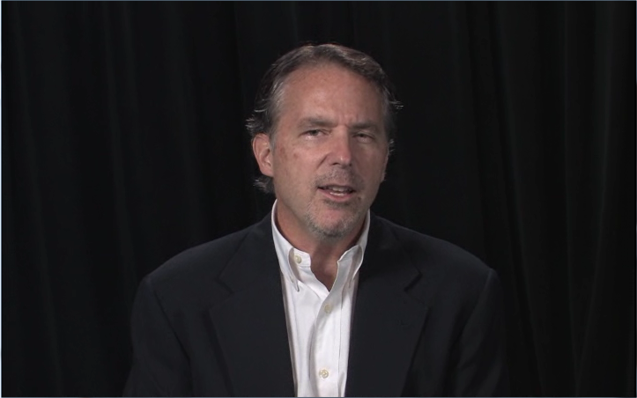



100
90
80
70
60
50
40
30
20
10
0
9
For illustrative purposes only.
9
FOR INSTITUTIONAL INVESTOR USE ONLY - NOT FOR USE WITH THE PUBLIC
Notes:
With this as the backdrop, we conducted our own primary proprietary research to understand how clients might react to various approaches for referrals. We pulled from some of the most popular and embraced methods within our industry, and though these methods clearly work for some people sometimes, to the best of our knowledge, none of them had been scientifically tested with investors, so that is what we set out to do . Our partners in doing so were a group out of New York called Maslansky + Partners . We have collaborated with Maslansky + Partners since 2007 using a unique form of instant dial response research. The way it works is we gather groups of investors together, place dials like the one you see on the screen into their hands, and ask them to move the dials to the right if they like and believe what they are hearing and to the left if they do not. By taking this approach we're able to isolate specific words that work and words that do not.

Slide 10
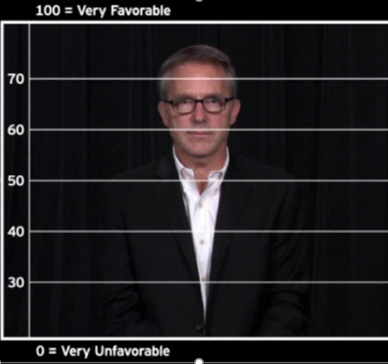
Traditional referral approaches often fall short
Sales threshold: Where “yes”
becomes probable
Free Offer: 57
Obligation: 45
Damage threshold: Where relationship
is at-risk
Exclusivity: 33
10
For illustrative purposes only.
10
FOR INSTITUTIONAL INVESTOR USE ONLY - NOT FOR USE WITH THE PUBLIC
Notes:
In this case, we tested 3 popular approaches to referrals that we found didn't get us to our goal. At best, they fell short of the “persuasion threshold” where our desired outcome is likely, and at worst, they actually upset and even angered clients.

Slide 11
Three steps to building your preferral
1. Preserving
client equilibrium
“You have probably noticed that I don’t often ask you for introductions. That’s because I_____________________________ _____________________________________________________
_____________________________________________________.
“At the same time, given all of the upheaval in the industry the last few years, I see some things that concern me. I see _____________________________________________________
_____________________________________________________
_____________________________________________________
_____________________________________________________.
“For those reasons, if there is anyone that you care
about, who you think might benefit from another pair of eyes,
I would be glad to help him/her.”
never want to make you feel
obligated or put on the spot .
2. Sharing concerns/
convictions
3. Close with an OFFER to help
clients who do not have a portfolios prepared for today’s
challenging investment environment. I’m also noticing that
many clients have financial professionals who are focused
only on liquid assets and not looking at their entire financial lives.
Examples shown are for illustrative purposes only
11
FOR INSTITUTIONAL INVESTOR USE ONLY - NOT FOR USE WITH THE PUBLIC
Notes:
Through a series of trial and error, however, we eventually found a “better mousetrap”! We call it the “Preferrals” method. It begins by preserving the client equilibrium and keeping the teeter-totter balanced by signaling that we understand the potential difficulty of asking for a referral and also that we don't want to put our client on the spot. It goes on to provide a template for you to customize for yourself personally and express some of your genuine observations and concerns that you see affecting investors today. The more passionately you feel about what you say here, the more effective your approach likely be. It finally it ends not with an ask, but instead with an offer to help. This is antithetical to what most of us have been trained to do. Many of us entered this business with someone coaching us to “ask for the order." What research tells us, though, is that this can easily backfire.
Advantage Coaching & Training's "'Preferrals' Coaching Study" conducted between February and November, 2012, found that the "Preferrals" method works roughly one in three times. Obviously, it's not a silver bullet and does not work every time, but it does much better than any other method we’ve been able to uncover.

Slide 12

If you like what you heard here today…
Join us for the “Preferrals” presentation
and ask your Invesco Consultant for the
“ ‘Preferrals’ Implementation Guide.”
  Summarizes today’s presentation and research
  Identifies potentially optimal clients for your preferral
  Guides in identifying potentially ideal times to use your preferral
  Provides coaching system to schedule the introduction
Brochure (VKC-PRF-BRO-2) image shown is for illustrative purposes only.
12
FOR INSTITUTIONAL INVESTOR USE ONLY - NOT FOR USE WITH THE PUBLIC
Notes:
We hope that you will try it for yourselves. In our short time together today we're not able to get into the detail on this program, but please join us later this month for our full-length presentation of “Preferrals.” If you would like more information in advance of that, please reach out to your Invesco consultant. Thank you!

Slide 13
"Preferrals" is based on Invesco Global Consulting's work with R.A. Prince & Associates, Inc., and Advantage Coaching & Training in addition to Invesco Global Consulting I-dials language testing with Maslansky + Partners . Invesco Distributors, Inc. is affiliated with neither R.A. Prince & Associates, Inc., Advantage Coaching & Training nor Maslansky + Partners.
This material is for illustrative, informational and educational purposes. If the illustrations herein are used outside of the designated audience, it is the respective user’s responsibility to ensure that such material complies with all applicable regulations and is filed with the appropriate regulatory bodies if so required. We make no guarantee that participation in this program or utilization of any of its content will result in increased business. This does not constitute a recommendation of any investment strategy or product for a particular investor. Investors should consult a financial professional/financial consultant before making any investment decisions.
The opinions expressed are those of the author and are subject to change without notice. These opinions may differ from those of other Invesco investment professionals.
All data created and produced by Invesco Global Consulting unless otherwise noted.
Note: Not all products, materials or services available at all firms. Financial professionals should contact their home offices.
FOR INSTITUTIONAL INVESTOR USE ONLY - NOT FOR USE WITH THE PUBLIC
Invesco.com/ic ©2021 Invesco Ltd. All rights reserved. Invesco Distributors, Inc. IGC-CON-PPT-2 05/21 NA5299
13

Slide 14
Not a Deposit | Not FDIC Insured
Not Guaranteed by the Bank | May Lose Value
Not Insured by any Federal Government Agency

